Slide 1


Improve wire EDM performance at different machining parameters – ANFIS modeling
Ibrahem Maher
PHD student in Mechanical Engineering Department, University of Malaya, Malaysia

Slide 2
Outline
Introduction
Problem Statement
Literature Review
Objectives
Experimental work
ANFIS Modelling
Results and discussion
Conclusion
Reference

Slide 3
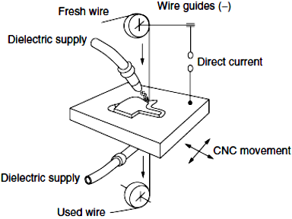
Introduction
Wire EDM Process
WEDM is an electro-thermal machining process for conductive and difficult to cut materials.
A metal wire electrode with de-ionized water is used to machine metal by the heat produced from electrical sparks.

Slide 4
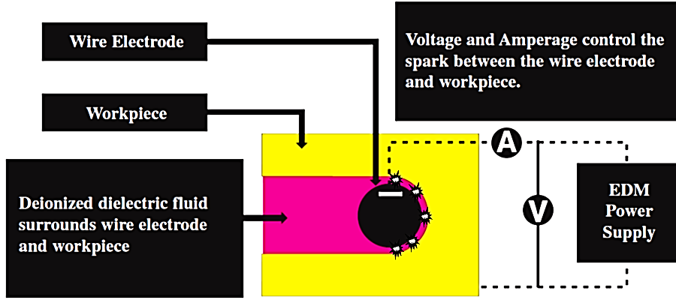
Introduction
Wire EDM Process
A pulse voltage is applied between the wire electrode and workpiece in the processing fluid to melt or evaporate the surface of the workpiece by the thermal energy of an electric discharge.
The main 4 parameters of this process are :
1 – Electrical parameters 2 – Electrode parameters
3 – Dielectric fluid ( non electrical parameters) 4 – Workpiece parameters

Slide 5
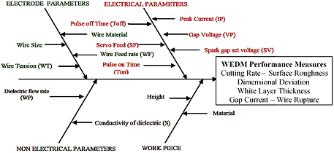
Introduction
Wire EDM Process Parameters
Selection of the correct process parameters for WEDM to get good performance is a very hard task.

Slide 6
Problem Statement
W-EDM process
1 - generates high surface roughness (Low surface quality).
  2 - produces large heat affected zone thickness
3 - exhibits slow cutting speed (Low productivity).
4 - may lead to wire rupture (due to high temperature and high wire tension).
5 – there is no any exact mathematical equations between the above performance measures and the controllable parameters.

Slide 7
Literature review
Literature gaps
Limited studies about effect of cutting parameters on heat affected zone and wire rupture.
Very little work has been reported on to find change in mechanical properties and surface integrity of WEDM worked material
Limited studies about multi response optimization.
Few efforts have been done to identify electrode materials, keeping in view their thermal properties from the point of view of cutting speed.
Notes:
After rich search of the published work in this field, the literature gaps can be drawn

Slide 8
Objectives
Improve wire EDM performance at different cutting parameters .
Cutting parameters include: pulse on time, peak current, and wire tension.
Process performance include: surface roughness, cutting speed, Heat affected zone.
Develop an adaptive neuro-fuzzy inference system (ANFIS) model to predict performance parameters.

Slide 9
EXPERIMENTAL WORK
Experimental setup
Machining parameters setting
Sodick A500W WEDM machine tool
Brass wire with a diameter of 0.2 mm and tensile strength of 1000 N/mm2.
AISI 1050 carbon steel.
The CS is recorded directly from the WEDM machine tool monitor.
The Ra was measured with a stylus-based profilometers.
SEM is used to examine the surface characteristics and HAZ of the machined part.
Machining parameter | Levels
Pulse on time (µs) | 0.15 | 0.20 | 0.25
Wire tension (g) | 300 | 350 | 400
Peak current (A) | 16 | 17 | -
Notes:
The other machining parameters were kept constant as a fixed value during experiments to optimize the process.

Slide 10
EXPERIMENTAL Results
Measured CS (mm/min), Ra (µm), and HAZ (µm) at different machining conditions
No. | Machining parameters |  |  | Performance characteristics
 | IP | Ton | WT | CS | RA | HAZ
1 | 16 | 0.15 | 300 | 0.59 | 2.46 | 10.23
2 |  |  | 350 | 0.58 | 2.4 | 9.36
3 |  |  | 400 | 0.63 | 2.36 | 9.89
4 |  | 0.2 | 300 | 0.67 | 2.59 | 16.72
5 |  |  | 350 | 0.69 | 2.51 | 16.79
6 |  |  | 400 | 0.69 | 2.43 | 17.55
7 |  | 0.25 | 300 | 0.84 | 2.85 | 19.44
8 |  |  | 350 | 0.83 | 2.79 | 19.22
9 |  |  | 400 | 0.85 | 2.72 | 19.44
10 | 17 | 0.15 | 300 | 0.82 | 2.52 | 13.35
11 |  |  | 350 | 0.79 | 2.48 | 12.66
12 |  |  | 400 | 0.79 | 2.45 | 12.69
13 |  | 0.2 | 300 | 0.93 | 2.66 | 18.73
14 |  |  | 350 | 0.96 | 2.59 | 19.16
15 |  |  | 400 | 0.98 | 2.54 | 19.10
16 |  | 0.25 | 300 | 1.1 | 2.90 | 20.84
17 |  |  | 350 | 1.12 | 2.85 | 21.63
18 |  |  | 400 | 1.13 | 2.76 | 21.76
Notes:
The average CS was calculated from the three-recorded data under the same conditions. The average Ra was calculated for three different measurements under the same conditions with a sampling length of Lc=2.5 mm at a specific area of the workpiece. The average HAZ thickness was calculated from three measurements using ESM. Eighteen sets of data were used for training ANFIS, as summarized in Table 3.

Slide 11
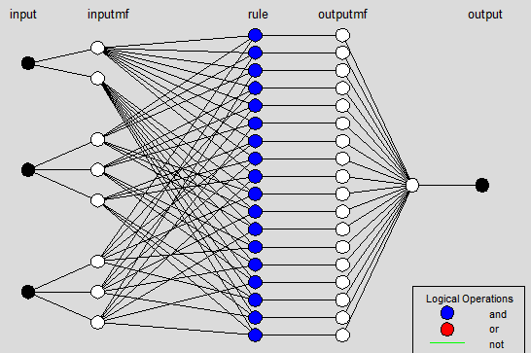
ANFIS MODELING
Notes:
ANFIS is a fuzzy inference system implemented in the framework of an adaptive neural network.

Slide 12
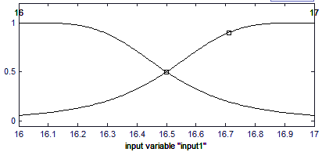
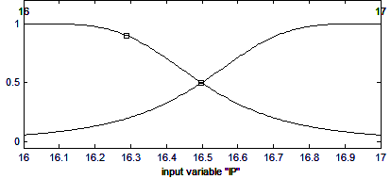
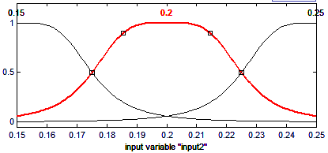
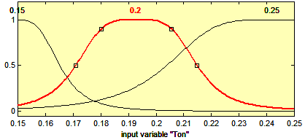
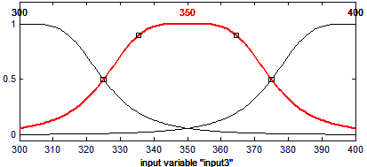
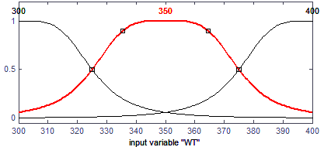
ANFIS MODELING
Membership functions
Initial
Membership
Functions
Final
Membership
Functions

Slide 13
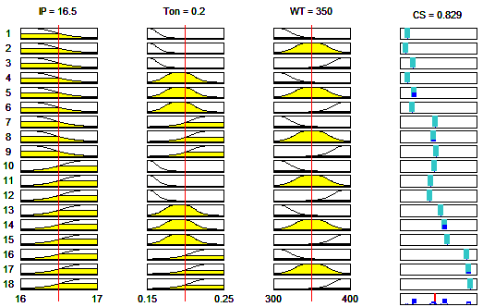
ANFIS MODELING
Rules
IF
AND
AND
THEN
IF
principle (antecedent), THEN
conclusion (resulting)
Notes:
ANFIS can be used to construct an input–output mapping based on human knowledge as fuzzy if-then rules as well as predetermined input–output data pairs for neural network training.

Slide 14
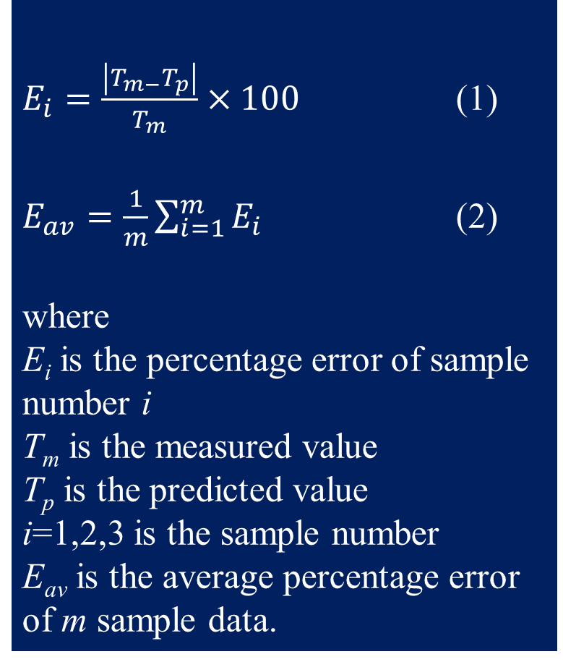
ANFIS MODELING
Verification
$E_{i}=\frac{\left|T_{m−}T_{p}\right|}{T_{m}}×100$ (1)
$E_{av}=\frac{1}{m}\sum_{i=1}^{m}{E_{i}}$ (2)
where
E_{i} is the percentage error of sample number i
T_{m} is the measured value
T_{p} is the predicted value
i=1,2,3 is the sample number
E_{av} is the average percentage error of m sample data.
Machining parameters |  |  | Performance characteristics |  |  |  |  |  | Error percent
 |  |  | Measured |  |  | ANFIS
IP | Ton | WT | CS | Ra | HAZ | CS | Ra | HAZ | CS | Ra | HAZ
A | µs | g | m/min | µm | µm | m/min | µm | µm | E_{i} ( %)
16.5 | 0.175 | 325 | 0.79 | 2.39 | 17.41 | 0.762 | 2.53 | 16.6 | 3.54 | 5.86 | 4.65
 |  | 375 | 0.81 | 2.38 | 16.76 | 0.781 | 2.47 | 16.9 | 3.58 | 3.78 | 0.84
 | 0.225 | 325 | 0.90 | 2.85 | 18.49 | 0.941 | 2.79 | 19.6 | 4.44 | 2.11 | 6.00
 |  | 375 | 0.97 | 2.62 | 18.87 | 0.952 | 2.72 | 19.8 | 2.06 | 3.82 | 4.93
E_{av} |  |  |  |  |  |  |  |  | 3.41 | 3.89 | 4.10
Notes:
To evaluate the Fuzzy model, the percentage error Ei and average percentage error Eav defined in Eqs. (2) and (3), respectively, were used.
Table 3 Comparison of measured and predicted CS (mm/min), Ra (µm), and HAZ (µm) for the testing data set

Slide 15
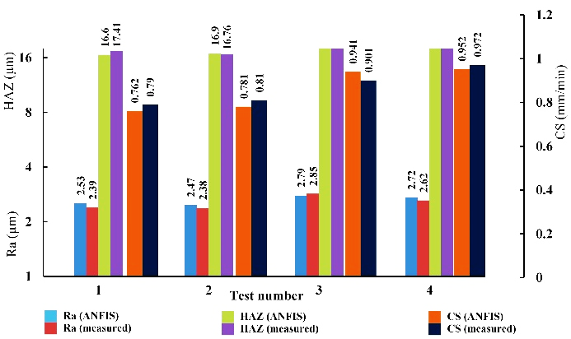
ANFIS MODELING
Error
The obtained average percentage error is 3.41, 3.89, and 4.1 for CS, Ra and HAZ respectively.
Notes:
Fig. 7 Measured versus predicted CS, Ra, and HAZ
The low error level signifies that the CS, Ra, and HAZ results predicted by ANFIS are very close to the actual experimental results. The error values mean that the proposed model can predict CS, Ra, and HAZ satisfactorily.

Slide 16
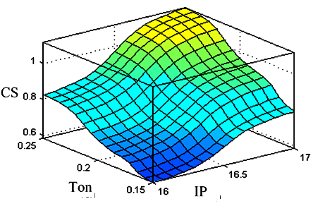
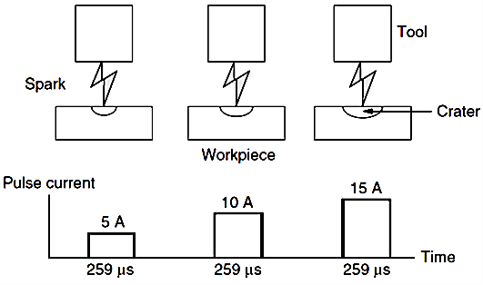
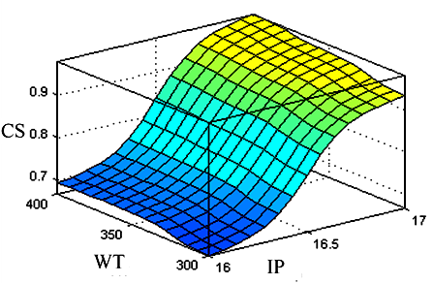
Results and discussion
Cutting speed
a
a
b
b
hm α (V IP Ton)1/3 (3)
Notes:
Fig. 1 The modeled cutting speed (CS) by ANFIS in relation to parameters change, a) CS in relation to change of Pulse on time (Ton) and peak current (IP), and b) CS in relation to change of wire tension (WT) and peak current (IP).
Fig. 2 Effect of spark energy on removal rate and surface roughness. a) Effect of pulse current on removal rate and surface roughness. b) Effect of pulse on time on removal rate and surface roughness.

Slide 17
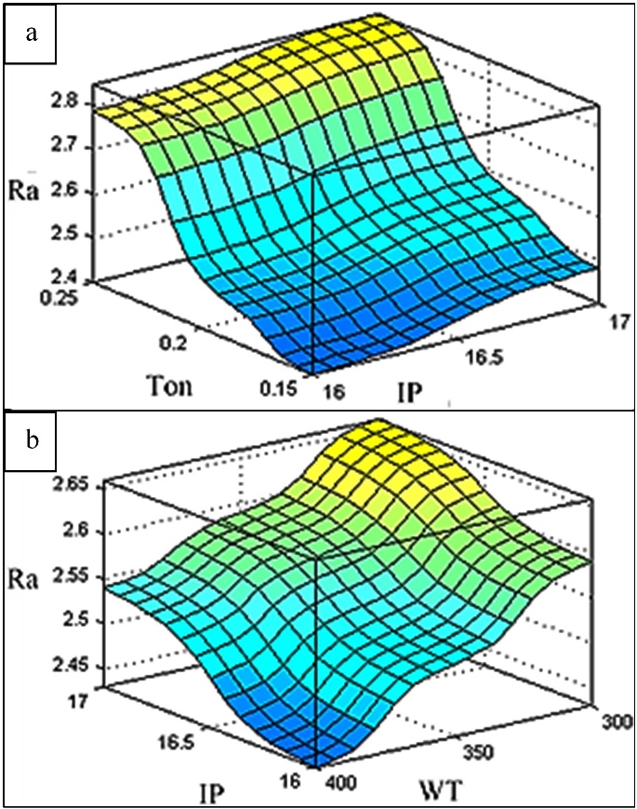
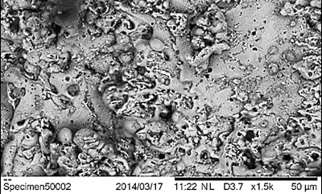
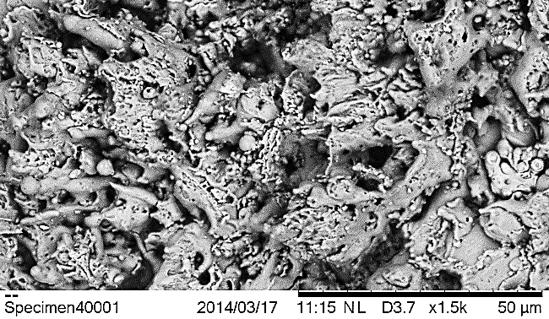
Results and discussion
Surface roughness
a
Low surface roughness
b
High surface roughness
Notes:
Fig. 3 The modeled Surface roughness (Ra) by ANFIS in relation to parameters change. a) Ra in relation to change of Pulse on time (Ton) and peak current (IP). b) Ra in relation to change of wire tension (WT) and peak current (IP).
Fig. 4 SEM micrograph at different levels of spark energy. a) SEM micrograph at the lowest levels of peak current (IP=16A) and pulse on time (Ton=0.15µs). b) SEM micrograph at the highest levels of peak current (IP=17A) and pulse on time (Ton=0.25µs)

Slide 18
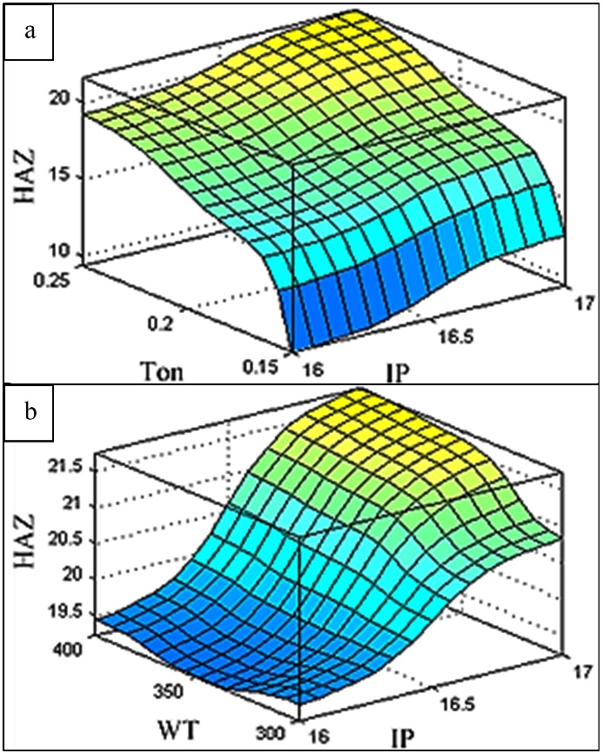
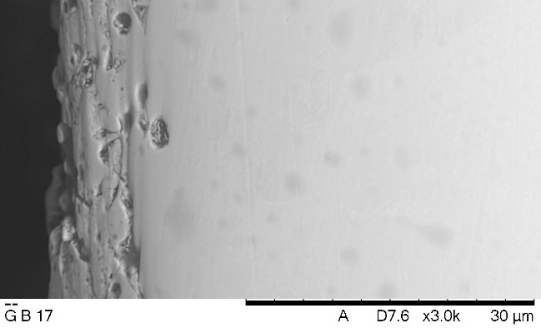
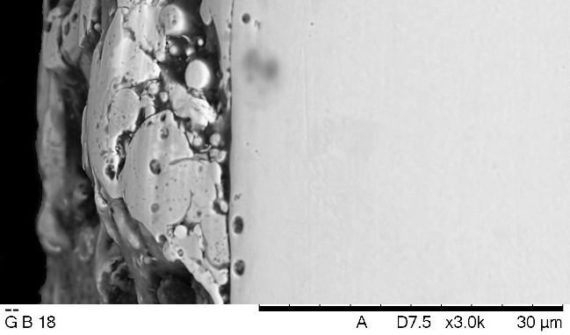
Results and discussion
Heat affected zone
a
9.36 µm
b
21.76 µm
Notes:
fig. 5 The modeled Heat affected zone (HAZ) by ANFIS in relation to parameters change. a) HAZ in relation to change of Pulse on time (Ton) and peak current (IP). b) HAZ in relation to change of wire tension (WT) and peak current (IP).
Fig. 6 SEM micrograph at different levels of spark energy. a) SEM for the lowest levels of peak current (IP=16A) and pulse on time (Ton=0.15µs). b) SEM micrograph for the highest levels of peak current (IP=17A) and pulse on time (Ton=0.25µs).

Slide 19
conclusion
This study presents an experimental investigation of WEDM for improving the process performance.
ANFIS was successfully used to develop an empirical model for modeling the relation between the predictor variables (Ton, IP, and WT) and the performance parameters (CS, Ra, and HAZ).
ANFIS model with gbellmf is accurate and can be used to predict CS, Ra, and HAZ in WEDM.
To verity the ANFIS model, The predicted CS, Ra, and HAZ were compared with measured data, and the average prediction error for CS, Ra, and HAZ were 3.41, 3.89, and 4.1 respectively.
Also, This study concludes that the peak current and pulse on time are the most significant parameters affecting the cutting speed, surface roughness and heat affected zone. The wire tension has minor effect on the cutting speed and heat affected zone but it has considerable effect on the surface roughness.

Slide 20
Thank you

Slide 21
REFERENCES
BARZANI, M. M., SARHAN, A. A. D., FARAHANY, S., RAMESH, S. & MAHER, I. 2015. Investigating the Machinability of Al–Si–Cu cast alloy containing bismuth and antimony using coated carbide insert. Measurement, 62, 170-178.
BOBBILI, R., MADHU, V. & GOGIA, A. K. 2013. Effect of Wire-EDM Machining Parameters on Surface Roughness and Material Removal Rate of High Strength Armor Steel. Materials and Manufacturing Processes, 28, 364-368.
ÇAYDAŞ, U., HASÇALıK, A. & EKICI, S. 2009. An adaptive neuro-fuzzy inference system (ANFIS) model for wire-EDM. Expert Systems with Applications, 36, 6135-6139.
EL-HOFY, H. 2005. Advanced machining processes, McGraw-Hill.
GÖKLER, M. İ. & OZANÖZGÜ, A. M. 2000. Experimental investigation of effects of cutting parameters on surface roughness in the WEDM process. International Journal of Machine Tools and Manufacture, 40, 1831-1848.
HEWIDY, M., EL-TAWEEL, T. & EL-SAFTY, M. 2005. Modelling the machining parameters of wire electrical discharge machining of Inconel 601 using RSM. Journal of Materials Processing Technology, 169, 328-336.
HO, K. H., NEWMAN, S. T., RAHIMIFARD, S. & ALLEN, R. D. 2004. State of the art in wire electrical discharge machining (WEDM). International Journal of Machine Tools and Manufacture, 44, 1247-1259.
HUANG, J. T., LIAO, Y. S. & HSUE, W. J. 1999. Determination of finish-cutting operation number and machining-parameters setting in wire electrical discharge machining. Journal of Materials Processing Technology, 87, 69-81.
JANG, J.-S. R., SUN, C.-T. & MIZUTANI, E. 1997. Neuro-fuzzy and soft computing : a computational approach to learning and machine intelligence, U.S.A., Prentice Hall, Inc.
JANGRA, K., GROVER, S. & AGGARWAL, A. 2011. Simultaneous optimization of material removal rate and surface roughness for WEDM of WC-Co composite using grey relational analysis along with Taguchi method. International Journal of Industrial Engineering Computations, 2, 479-490.
KRUTH, J. P., VAN HUMBEECK, J. & STEVENS, L. 1995. Micro structural investigation and metallographic analysis of the white layer of a surface machined by electro discharge machining. Proceedings of international symposium for electromachining isem 11. Les Presses Polytechniques Romandes , Lausanne, Switzerland.
KUMAR, K. & AGARWAL, S. 2012. Multi-objective parametric optimization on machining with wire electric discharge machining. The International Journal of Advanced Manufacturing Technology, 62, 617-633.
MAHER, I., ELTAIB, M. E. H. & EL-ZAHRY, R. M. Surface roughness prediction in end milling using multiple regression and adaptive neuro-fuzzy inference system. International Conference on Mechanical Engineering Advanced Technology For Industrial Production, 12-14/December 2006 Assiut University, Egypt. Assiut University, 614-620.

